Slide 1

Tutoring App Draft 1
By: Maryrose Dooley

Slide 2


Login Concept for Using the App
IIT Tutors
IIT Tutors
IIT Tutors
Username
IIT Tutors
Login Screen:
Note – It will also include a sign up and document
emdolly2
IIT Tutors
Password
IIT Tutors
Pretend logo to get us started.
Loading screen if needed
****************
Concept for a loading bar.

Slide 3
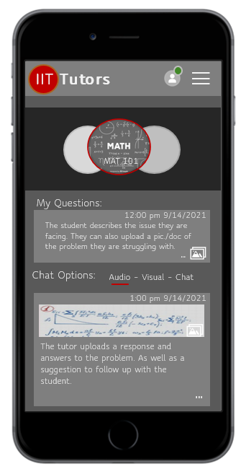

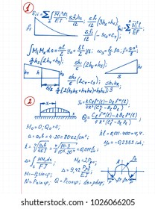

Normal View
Student profile picture &Tutor available in that section.
Picture View
Student View Of Class & Tutoring Session
IIT Tutors
Website banner/ header.
IIT Tutors
More options
The tutoring sessions per class on a carousal.
MAT 251
Photo enhanced
Name of class and number
Tutoring class type selected.
Date and Time stamp
My Questions:
Students send a question and can upload a photo or document of the problem/s.
12:00 pm 9/14/2021
The student describes the issue they are facing. They can also upload a pic./doc of the problem they are struggling with.
…
Tutor profile and name
Chat Options:
Audio – Visual – Chat
Date and Time stamp response.
The student can choose three different methods of communication. The red line indicates the option selected in this case “Audio”.
Tutor Name
1:00 pm 9/14/2021
The tutor uploads a picture of how to solve the problem and notes from the meeting. (The picture shows a preview of the notes).
The tutor uploads a response and answers to the problem. As well as a suggestion to follow up with the student.
Show more content from the text
…

Slide 4
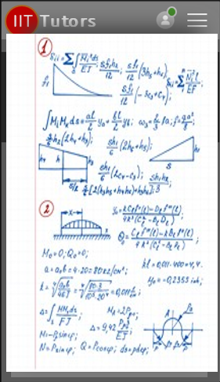
Student View Of Class & Tutoring Session
Without the words.
(Note: the picture resolution will be a clearer in the program).

Slide 5
Student View Of Class & Tutoring session
Long View

Slide 6
1
2
3
Concepts for Menu Design
IIT Tutors
Students Name
IIT Tutors
Students Name
Note:
Here are three different design types we can use for the menu.
Your Classes
Your Classes
Home Page
Home Page
Your Classes
About Us
About Us
Your Classes
Find Tutors
Find Tutors
Calendar
Calendar
Your Classes
Your Classes
Your Classes
Your Classes
Your Classes
Your Classes

